Slide 1


ANNAMACHARYA INSTITUTE OF TECHNOLOGY AND SCIENCES::TIRUPATI
(AUTONOMOUS)
DEPARTMENT OF COMPUTER SCIENCE AND ENGINEERING
T E C H N I C A L S E M I N A R
Advanced Database System
Presented By:
A. TEJASWINI, 19AK1A05H4
Seminar Incharge :
Ms. K. Susmitha, MTech
Assistant Professor CSE.
Head of The Department :
Mr. B. Ramana Reddy, MTech.(Ph.D)
Assistant Professor, CSE.

Slide 2
Contents
ABSTRACT
INTRODUCTION
ARCHITECTURE
MODUELS
ADVANCED DATA STRUCTURES
USE CASES
ADVANTAGES
APPLICATIONS
CONCLUSION
REFERENCES

Slide 3
ABSTRACT
Redis is an open-source, in-memory data structure store, used as a database, cache, and message broker. It supports multiple data structures including strings, hashes, lists, sets, sorted sets, bitmaps, hyperloglogs and geospatial indexes with radius queries. Its high-performance and horizontal scalability make it a popular choice for real-time web applications, gaming, analytics, and more. Redis also provides built-in replication, Lua scripting, LRU eviction, transactions, and various levels of on-disk persistence, which add to its reliability and versatility. With its simple and straightforward API, Redis is easy to use and integrate into existing applications. In this technical seminar, we will discuss the key features and use cases of Redis and dive into its architecture, data storage, and operations, followed by hands-on demonstrations and best practices for deployment and management.

Slide 4
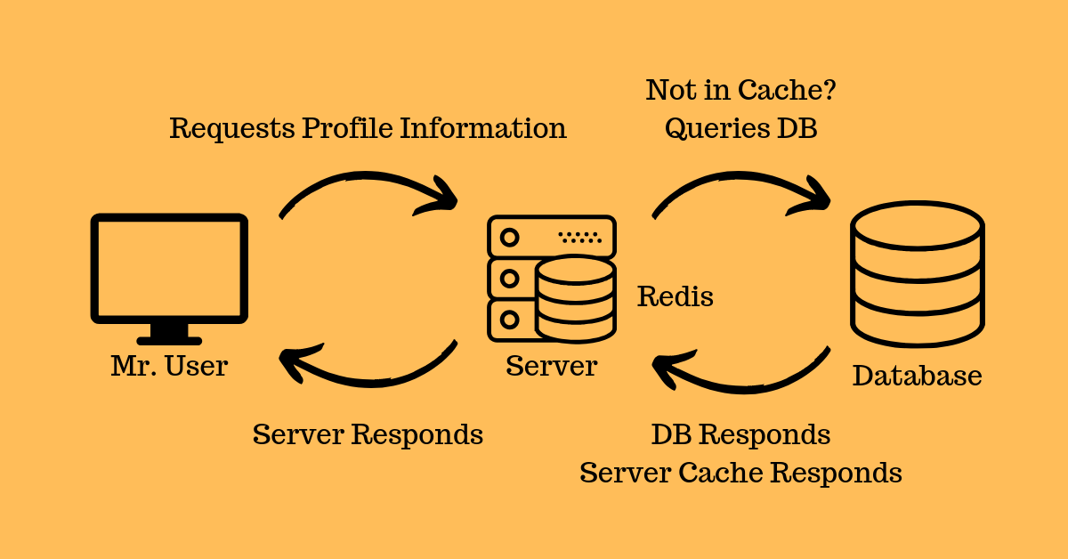
INTRODUCTION
Redis is a powerful, open-source, in-memory data structure store that has gained significant popularity over the years. Its versatility and high-performance capabilities make it an ideal solution for a wide range of applications such as real-time web applications, gaming, analytics, and more.
Redis supports multiple data structures, including strings, hashes, lists, sets, sorted sets, bitmaps, hyperloglogs, and geospatial indexes with radius queries. Its built-in replication, Lua scripting, LRU eviction, transactions, and various levels of on-disk persistence add to its reliability and flexibility.

Slide 5
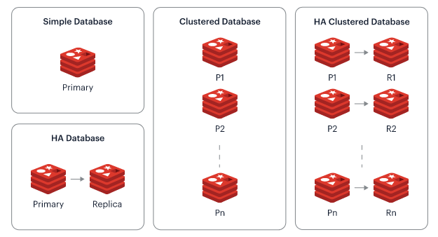
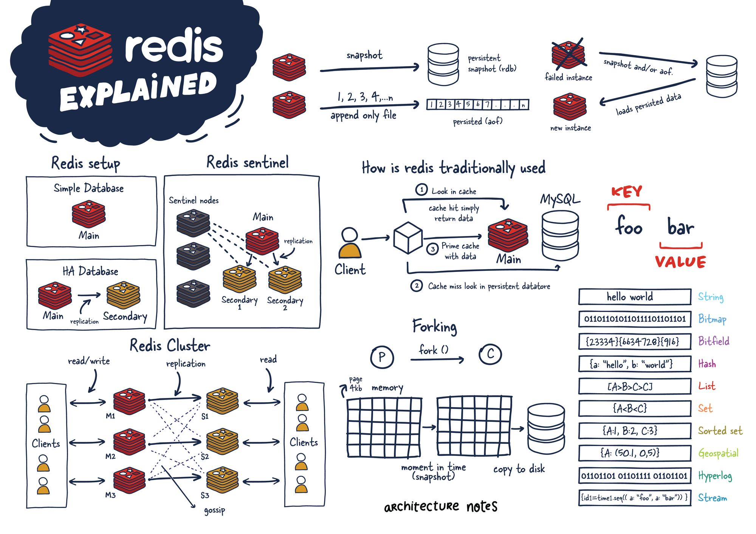
ARCHITECTURE

Slide 6
MODUELS
Redisearch - a full-text search engine module for Redis.
RedisJSON - a module that enables storing, retrieving, and querying JSON documents in Redis.
RedisGraph - a module that provides graph database functionality for Redis.
RedisBloom - a module that provides probabilistic data structures like Bloom filters, Count-Min Sketch, and Top-K for Redis.
RedisTimeSeries - a module that provides time-series data storage and analysis capabilities for Redis.
These modules can be installed separately and integrated with Redis to enhance its capabilities and provide additional functionality for specific use cases.

Slide 7
ADVANCED DATA STRUCTURES
Bitmaps - A data structure that represents a set of bits or flags, allowing efficient manipulation of binary data.
HyperLogLogs - A probabilistic data structure that allows for approximate counting of unique elements in a set, using a relatively small amount of memory.
Geospatial Indexes with Radius Queries - A data structure that allows for efficient indexing and querying of geographical coordinates, enabling location-based searches and calculations.

Slide 8
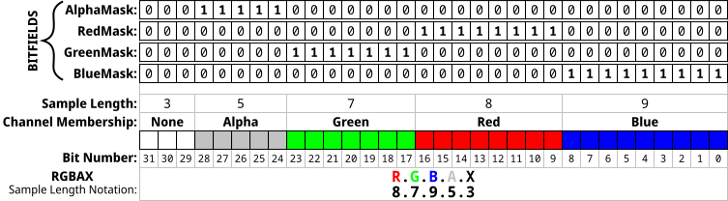
Example :
Bitmaps

Slide 9
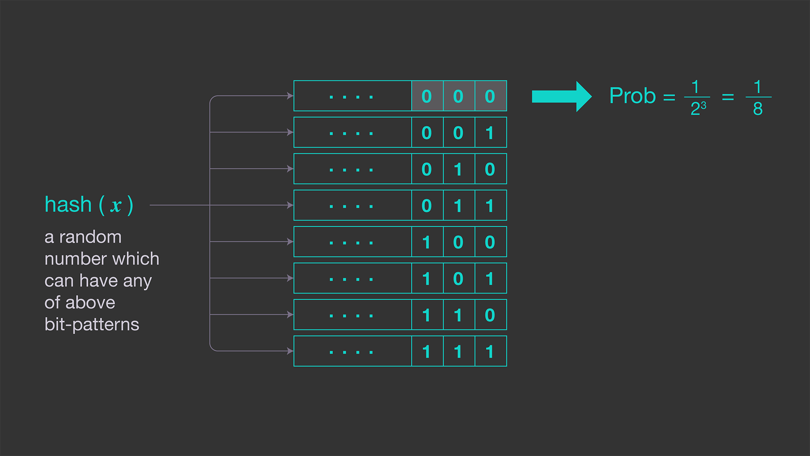
Example :
Hyperloglog

Slide 10
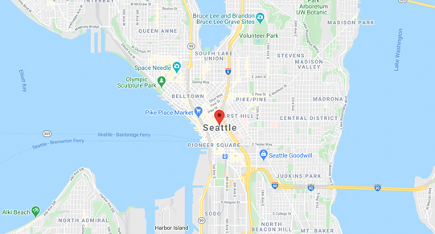

Example :
Geospatial queries in Redis

Slide 11
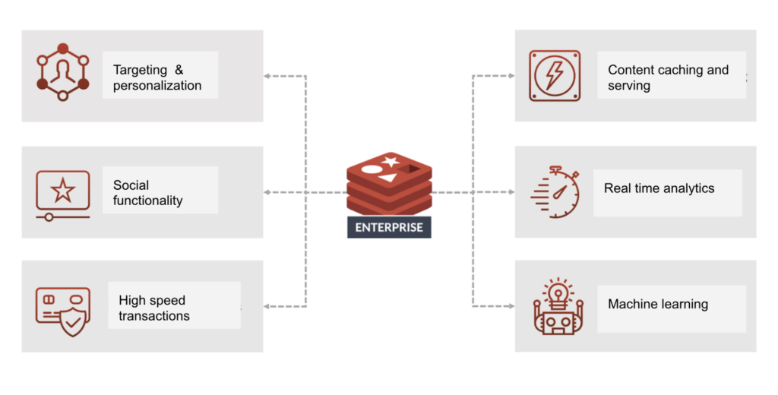
USE CASES

Slide 12
ADVANTAGES
High performance: Redis is designed for high performance and can handle millions of transactions per second.
Low latency: Redis can serve requests in microseconds, making it ideal for real-time applications.
Versatile data structures: Redis supports a wide variety of data structures, including lists, sets, hashes, and sorted sets, which can be used for various use cases.
Scalability: Redis can be scaled horizontally by using clustering and replication techniques.
Durability: Redis offers data persistence options, such as snapshotting and append-only files, to ensure data durability and prevent data loss.

Slide 13
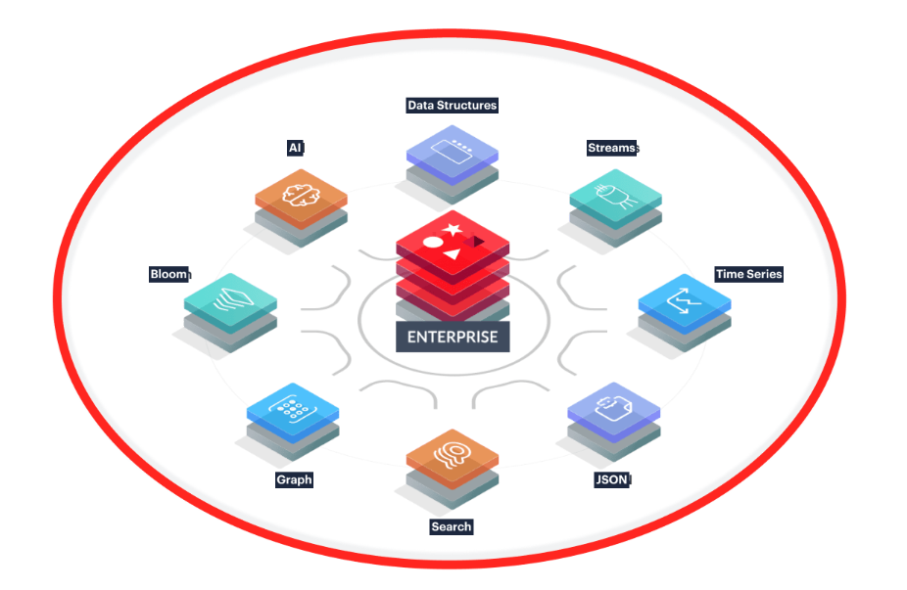
APPLICATIONS
Caching layer
Session management
Real-time analytics
Message broker
Pub/Sub messaging

Slide 14
CONCLUSION
In conclusion, Redis technology is a powerful, in-memory data store that can be used for a wide range of applications.
Its high performance, low latency, and versatile data structures make it an ideal choice for caching, session management, real-time analytics.
Additionally, Redis offers scalability and durability options, allowing it to handle large amounts of data and ensuring data persistence.
With its many benefits and use cases, Redis technology is a valuable tool for developers and businesses alike.

Slide 15
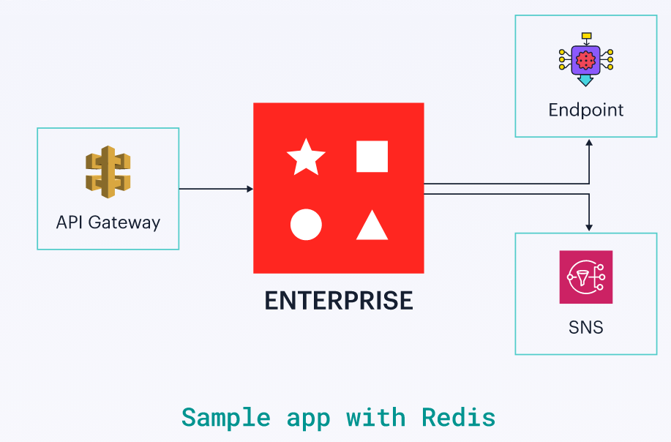
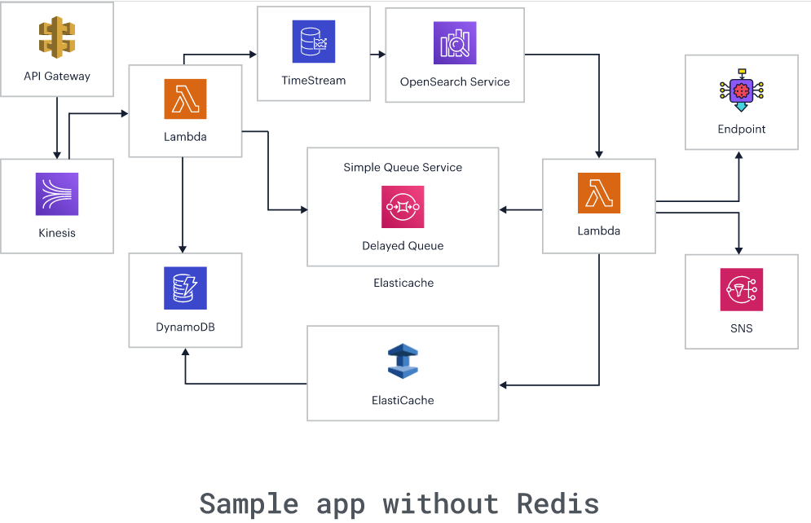

Slide 16
REFERENCES
https://redis.com/redis-enterprise/technology/redis-enterprise-cluster-architecture/
https://redis.io/resources/modules/
https://redis.io/docs/data-types/geospatial/
https://www.memurai.com/blog/geospatial-queries-in-redis
https://redis.com/blog/5-industry-use-cases-for-redis-developers/
https://redis.com/

Slide 17



